Slide 1

Session Name:
Network Optimization Problems
Delivered By:
Mr. Ritwik Sinha

Slide 2

Network Optimization Problems
Network models are applicable to an enormous variety of decision problems that can be modeled as networks optimization problems
Different prototype models of network optimization problems are:
Assignment Problem
Critical Path
Max Flow
Shortest Path
Transportation
Minimum Cost Flow Problem

Slide 3

Learning Objectives
By the end of this session, you will be able to:
Define nodes and arcs in Network Optimization Problems
Discuss Transportation and Shortest Path Problems

Slide 4
Nodes and Arcs
What is a Node?
Often called a vertex, or point. It is normally represented by a circle. In a transportation Network, these might be locations or cities on a map
What is an Arc?
Often called an edge, or arrow. It may be either directed or undirected. The head is the destination, the tail is the origin. The head and tail are Nodes that are at either end. In a transportation network, the Arcs might be roads, or navigation channels in rivers, or aircraft flight patterns. They supply connectivity between the Nodes. A one-way street might be represented by a directed arc. A two-way street might be an undirected arc or by two directed arcs that point in opposite directions.

Slide 5
Transportation Problem
The Transportation Problem is a Linear Programming (LP) problem used in network optimization to determine the most cost-effective way to transport goods from multiple sources (suppliers) to multiple destinations (customers) while minimizing costs.
Problem Statement:-
Given:
m supply points (factories, warehouses, sources)
n demand points (stores, distribution centers, destinations)
cij = Cost per unit of transporting goods from supply point i to demand point j
xij = Decision variable representing the quantity transported from supply point i to demand point j
si​ = Supply available at source i
dj = Demand required at destination j

Slide 6
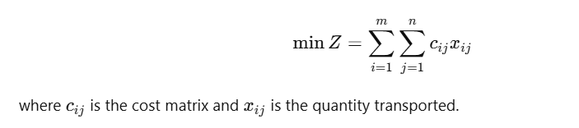



Transportation Problem
Objective Function (Minimize Total Transportation Cost):
Constraints:
Supply Constraints - Each supplier cannot send more than its available supply
Demand Constraints - Each destination must receive exactly its demand
Non-Negativity Constraints -

Slide 7
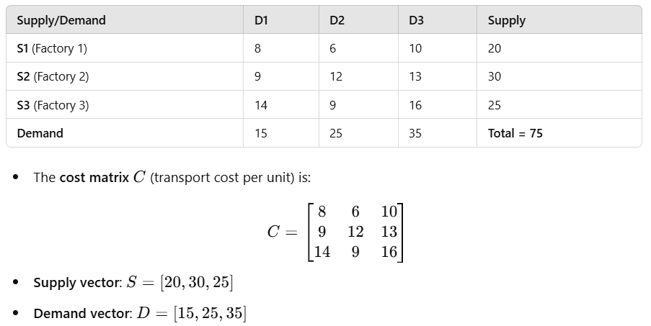
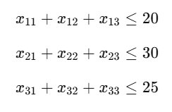
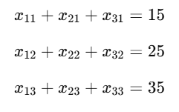

Transportation Problem

Slide 8
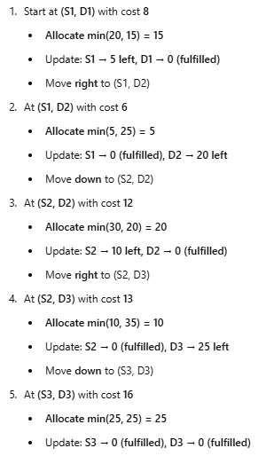
Transportation Problem
Applying North-West Corner Rule

Slide 9
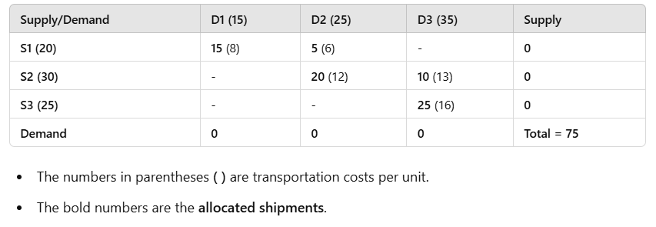
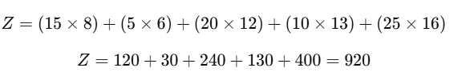
Transportation Problem
Allocation Table –
Total Transportatin Cost –

Slide 10
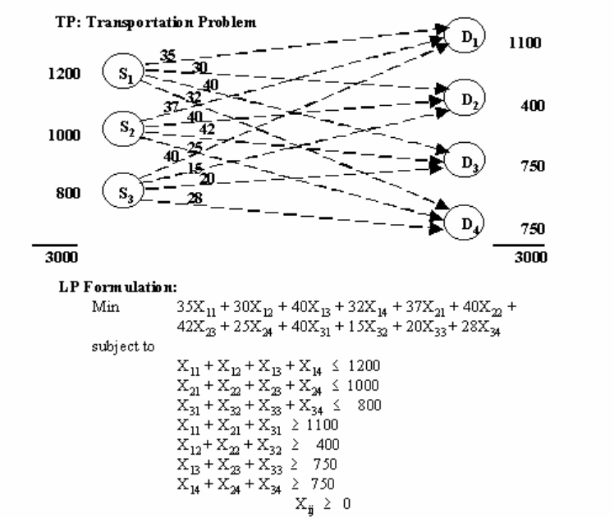

Slide 11
Academic Poll
In a transportation problem, the main objective is to:
A) Minimize transportation cost while satisfying supply and demand constraints. B) Maximize transportation time between sources and destinations. C) Increase the total demand beyond the given supply. D) Find the shortest route between two locations.
The Northwest Corner Rule is used to:
A) Find the optimal solution for the transportation problem. B) Find an initial feasible solution for the transportation problem. C) Check whether a transportation problem is balanced. D) Minimize the total cost of transportation directly.

Slide 12
Academic Poll
In a transportation problem, the main objective is to:
A) Minimize transportation cost while satisfying supply and demand constraints. B) Maximize transportation time between sources and destinations. C) Increase the total demand beyond the given supply. D) Find the shortest route between two locations.
The Northwest Corner Rule is used to:
A) Find the optimal solution for the transportation problem. B) Find an initial feasible solution for the transportation problem. C) Check whether a transportation problem is balanced. D) Minimize the total cost of transportation directly.

Slide 13
Session Summary
In this session, we have discussed about:
Introduction to Network Optimization Problems
Implementing Transportation Problems

Slide 14

Happy Learning!

